Slide 1
Setting up a Workshop Cluster
Weaveworks – https://weave.works – @weaveworks

Slide 2

Unless specified, these slides are © Weaveworks 2019.
They are made available under a Creative Common License.
Attribution-NonCommercial-ShareAlike 4.0 International (CC BY-NC-SA 4.0)
You can attribute in the following way:
“Created by Weaveworks / Derived from material created by Weaveworks.
Original available at https://tinyurl.com/k8s-workshop-setup”

Slide 3
Prerequisites
A Kubernetes Cluster
To which you have kubectl access

Slide 4
Outcomes
A Kubernetes Cluster
To which you have kubectl access
On which the Weave Cloud agents are installed
On which the workshop manifests are installed (With GitOps)

Slide 5
Setting up a workshop cluster

Slide 6
Install the Weave Cloud agents

Slide 7
GitOps hands-on 1/10
💻
Install Weave Cloud
https://cloud.weave.works
Follow the install wizard
Run the command in your console

Slide 8
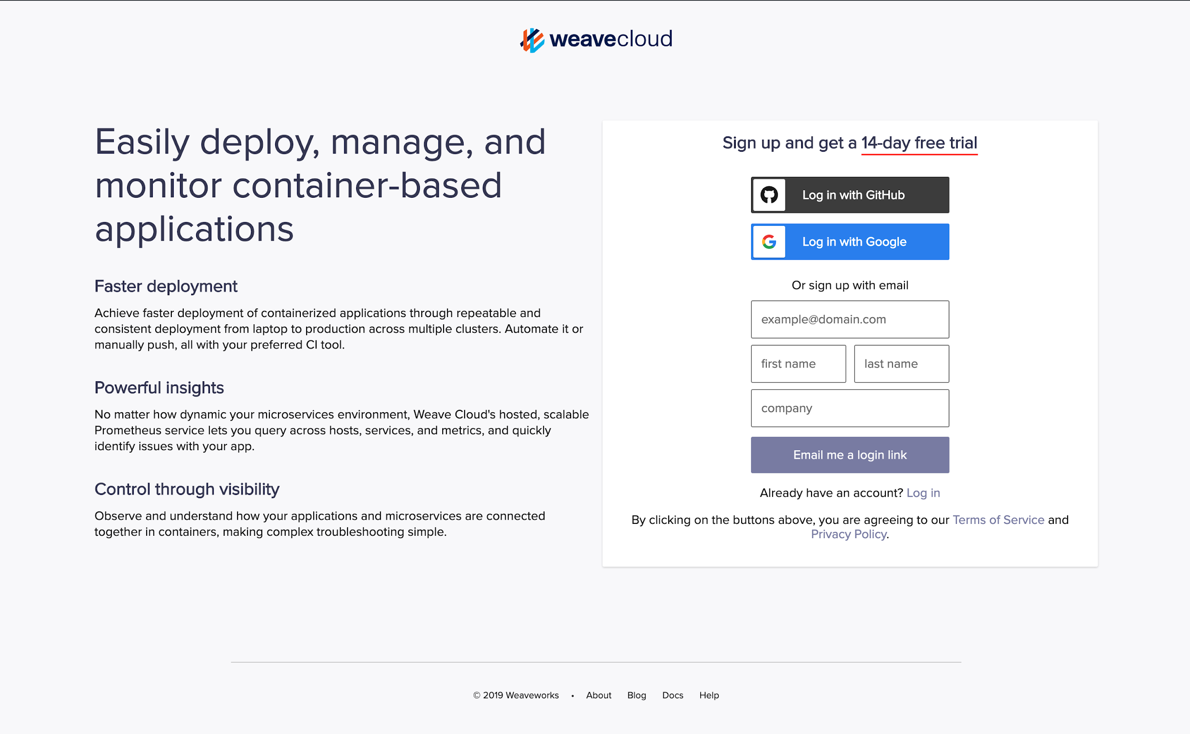

Slide 9
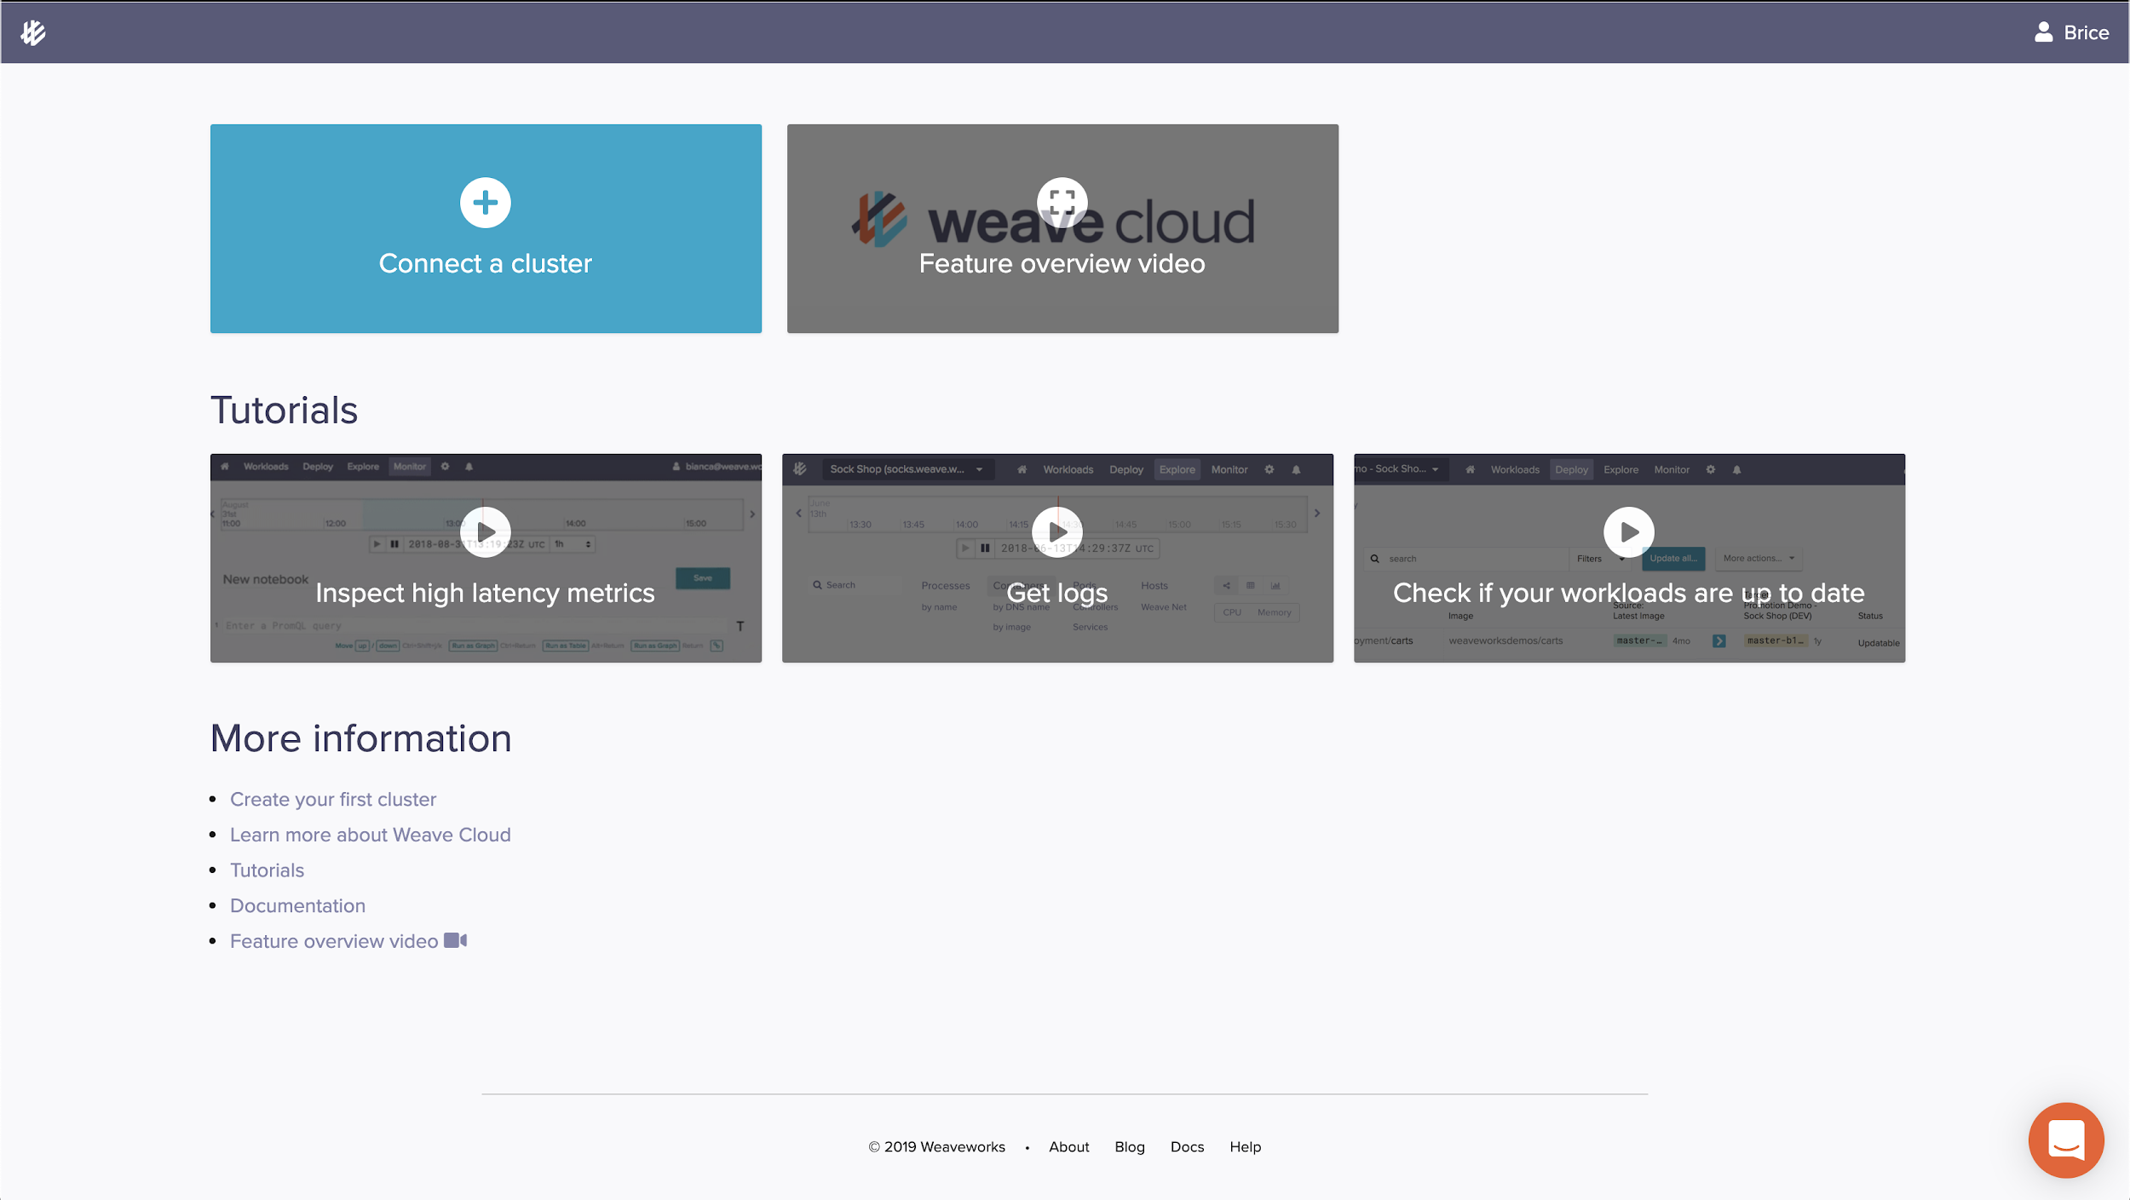
Click on “Connect a cluster”
1

Slide 10
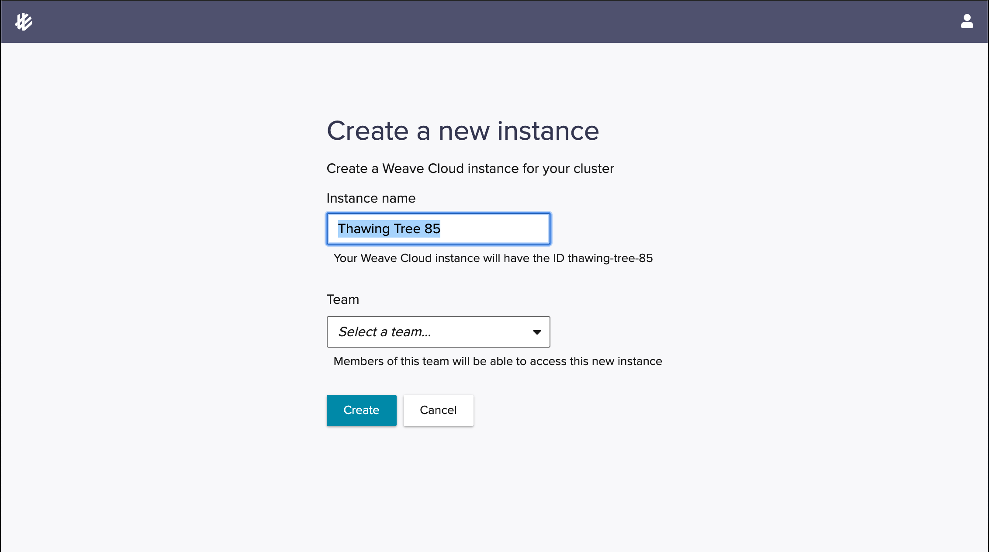
2
Give your cluster a name and click “Create”

Slide 11
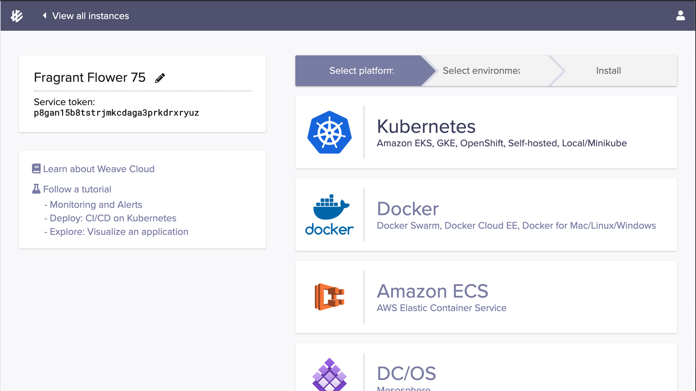
3

Slide 12
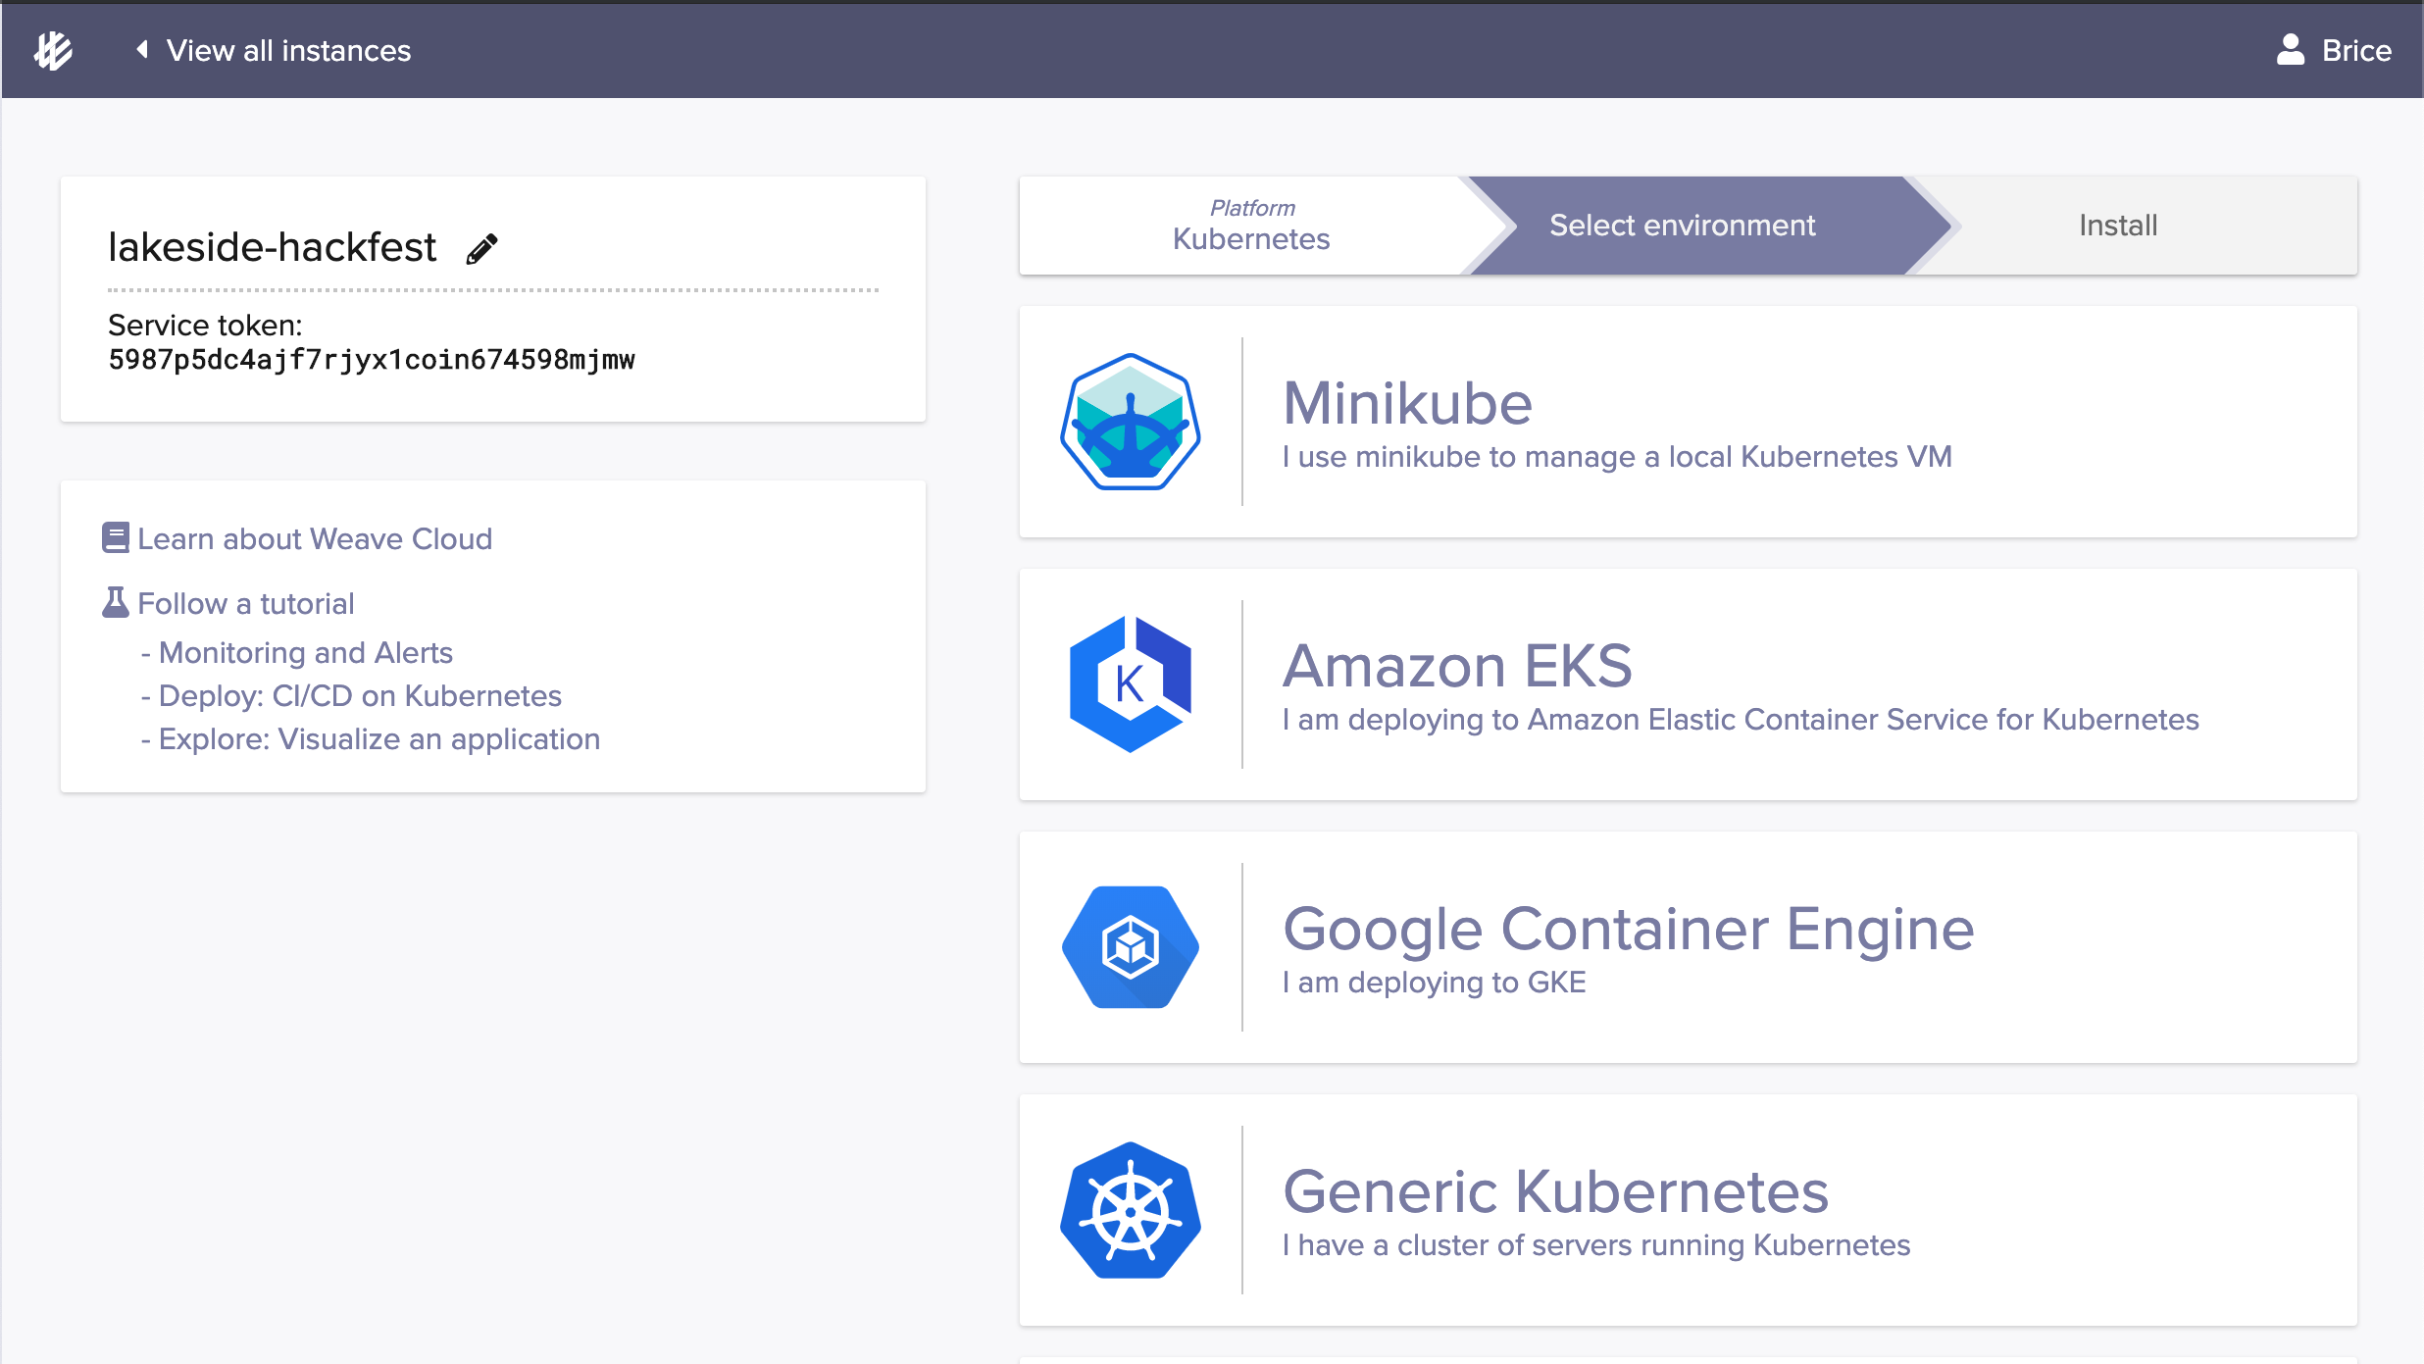
4
Pick the right environment

Slide 13
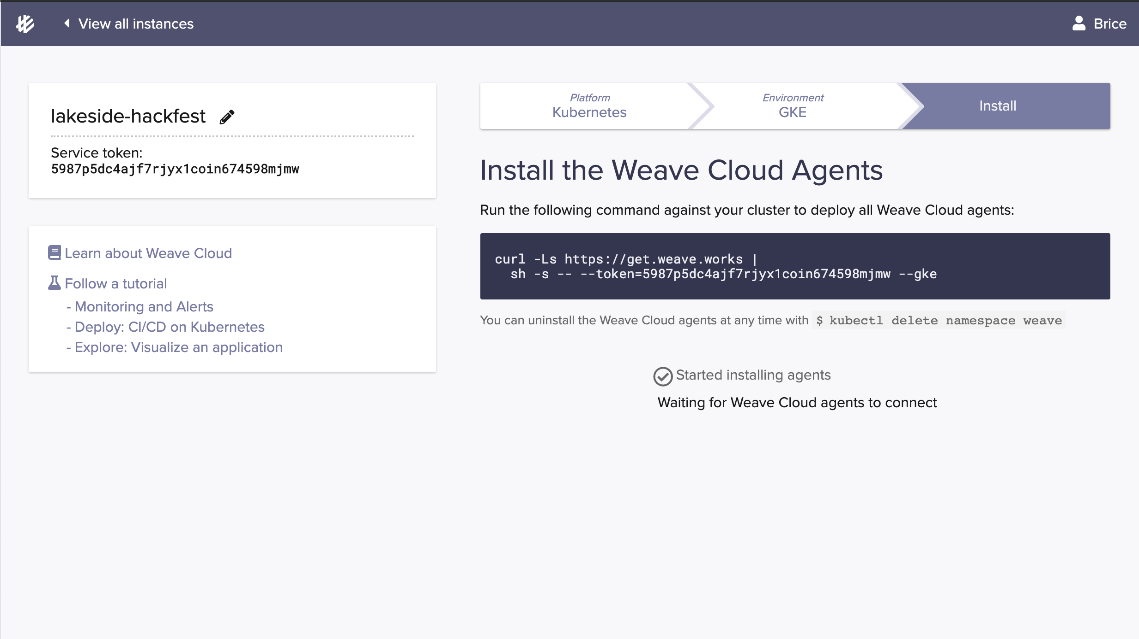
5
Copy the command into your terminal

Slide 14
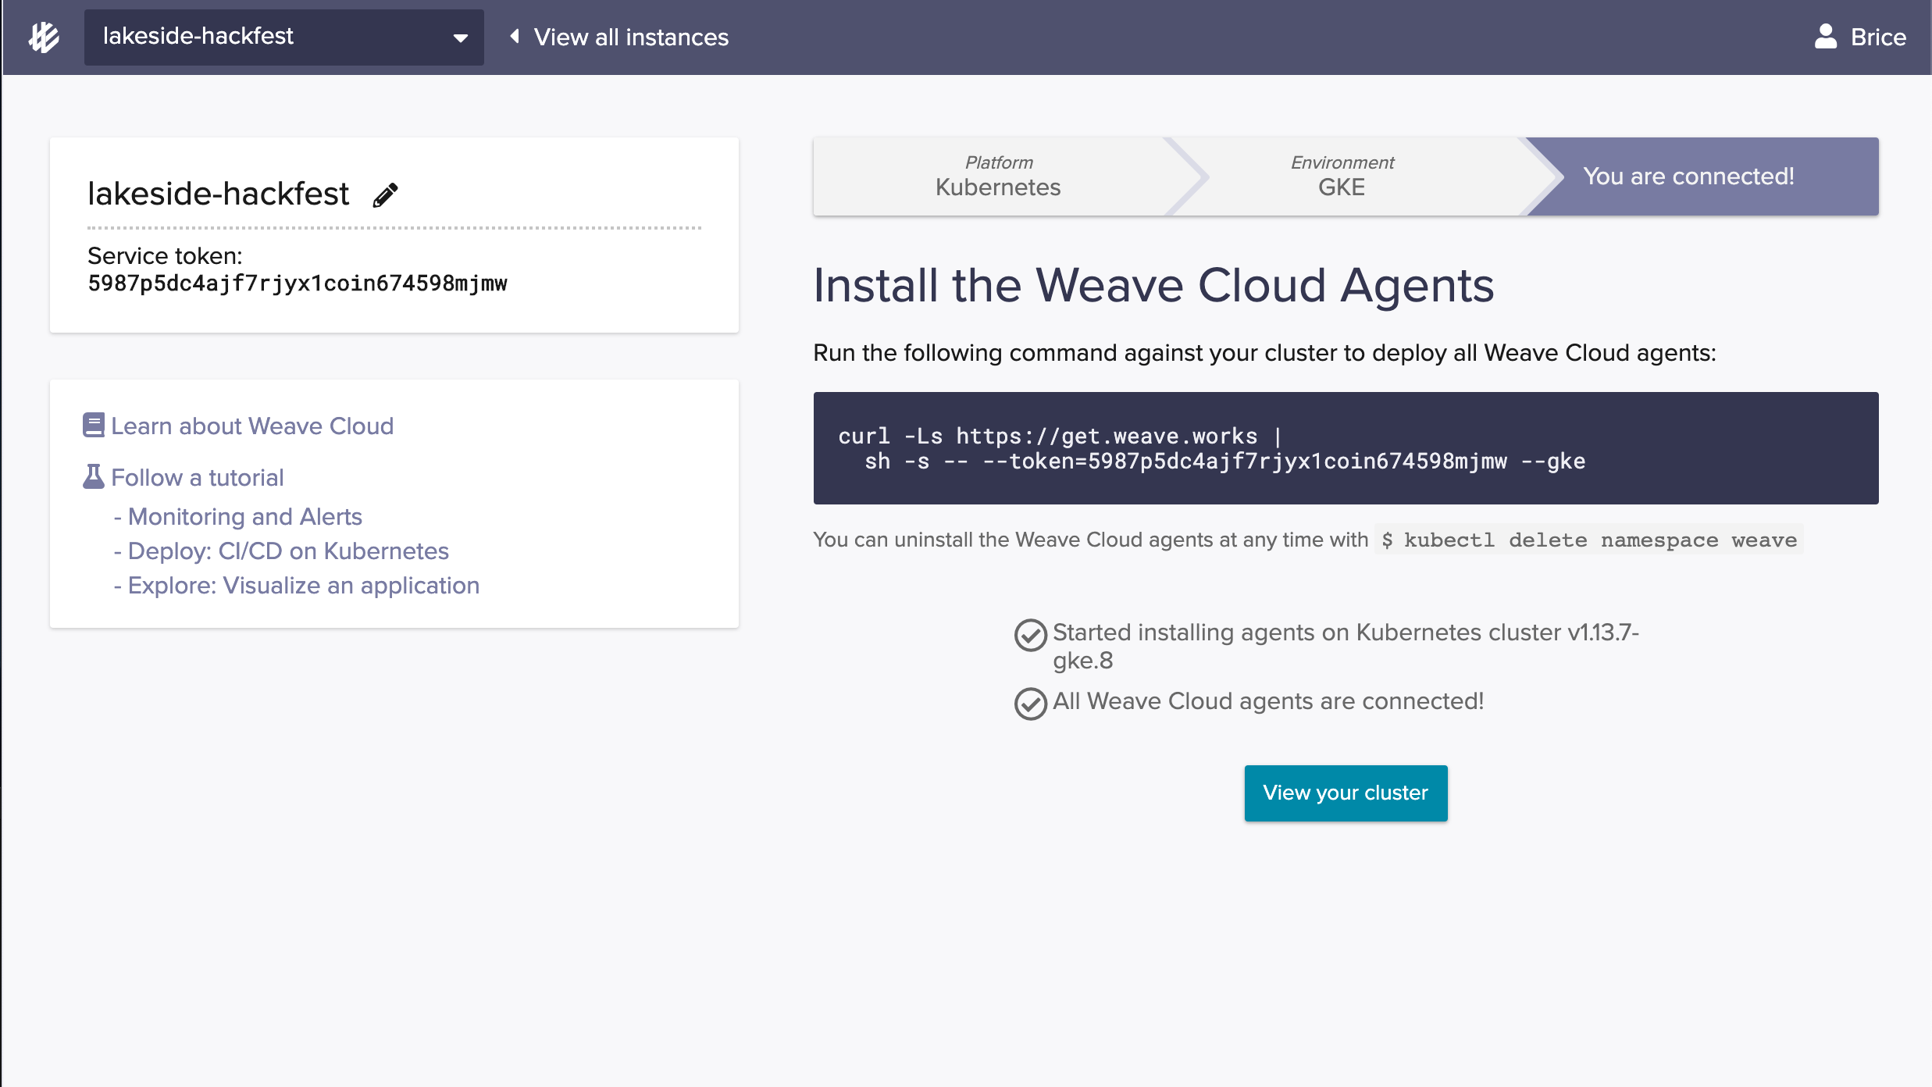
5
Wait for

Slide 15
GitOps hands-on 1/10
💻
Check what was installed
Look at what’s running on the cluster with
➤ kubectl get pods --all-namespaces

Slide 16
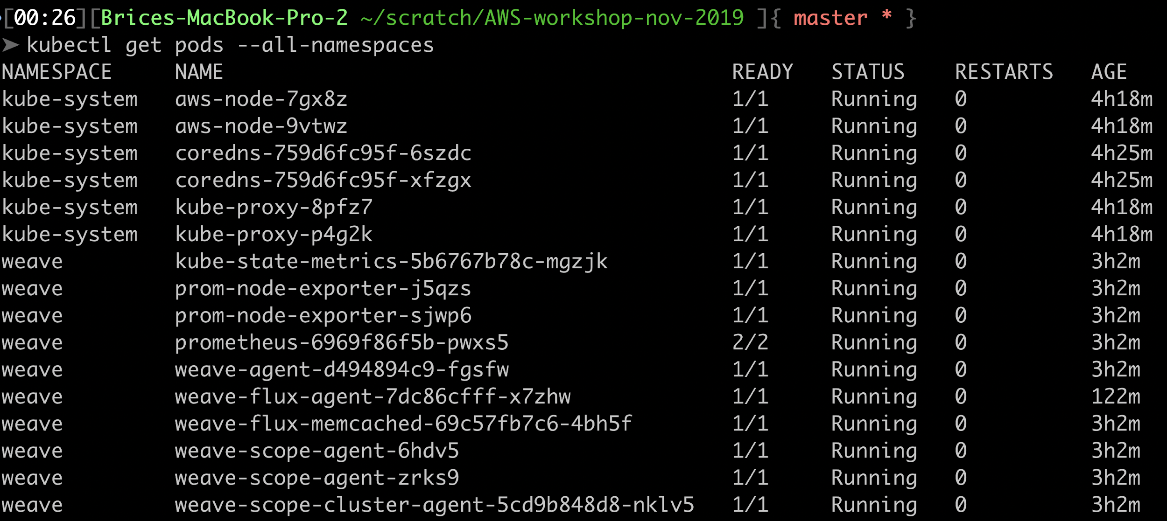
Checkpoint:
Weave agents running in cluster

Slide 17
Configure a control repository

Slide 18
GitOps hands-on 4/10
💻
1 – Fork the sample repository
Fork the configuration repository
https://github.com/bricef/podinfo-deploy
To your own Github or Bitbucket

Slide 19
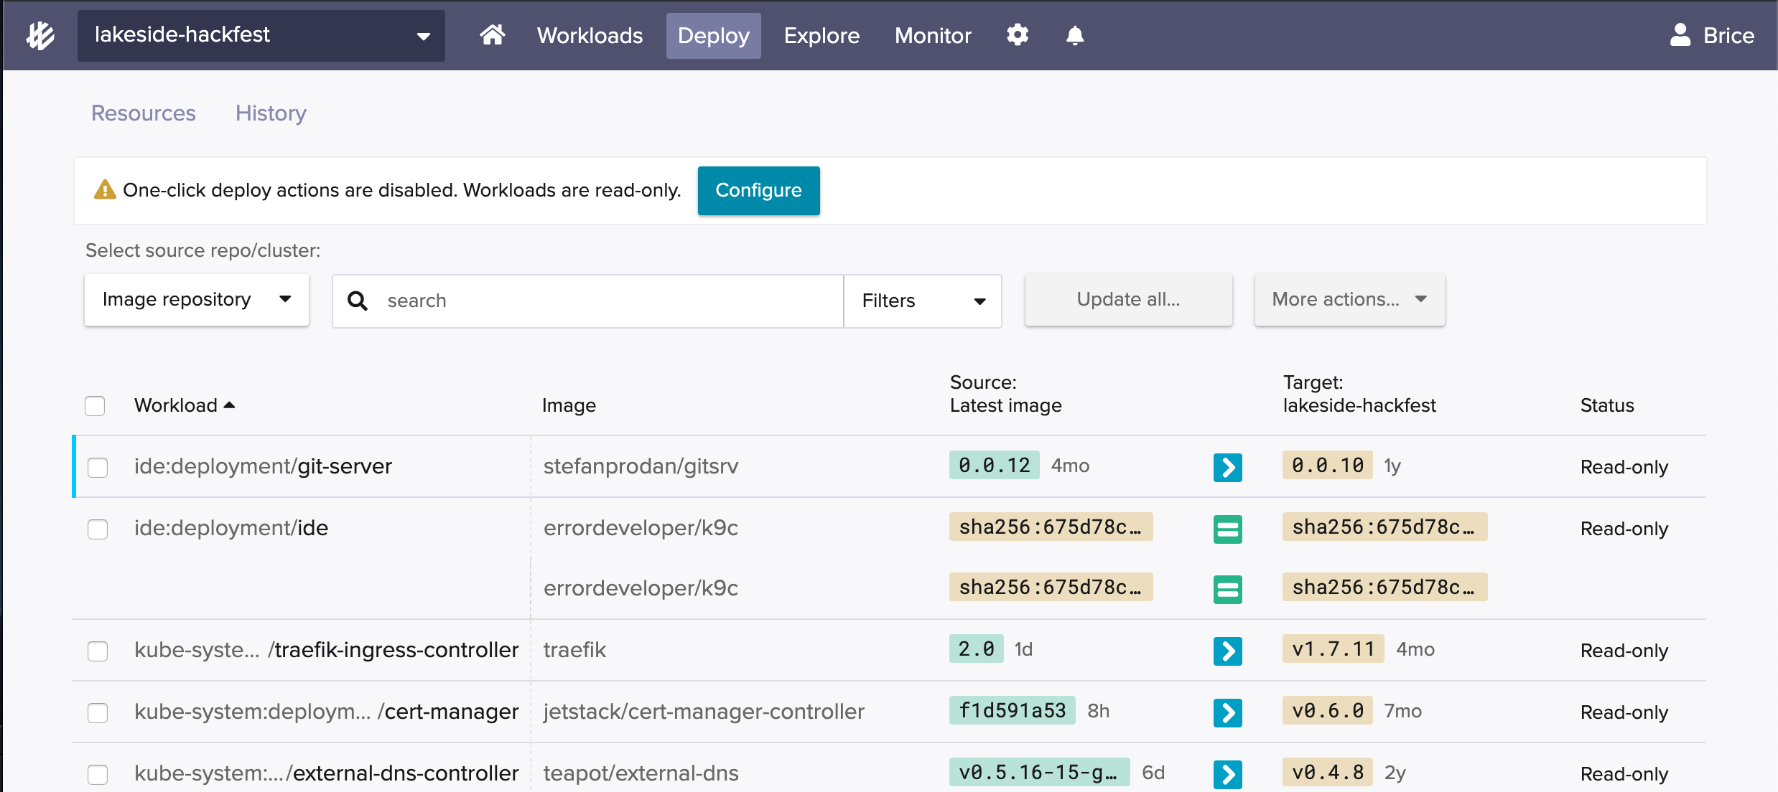
GitOps hands-on 4/10
💻
2 – Configure Flux to point to your repo
1
2

Slide 20
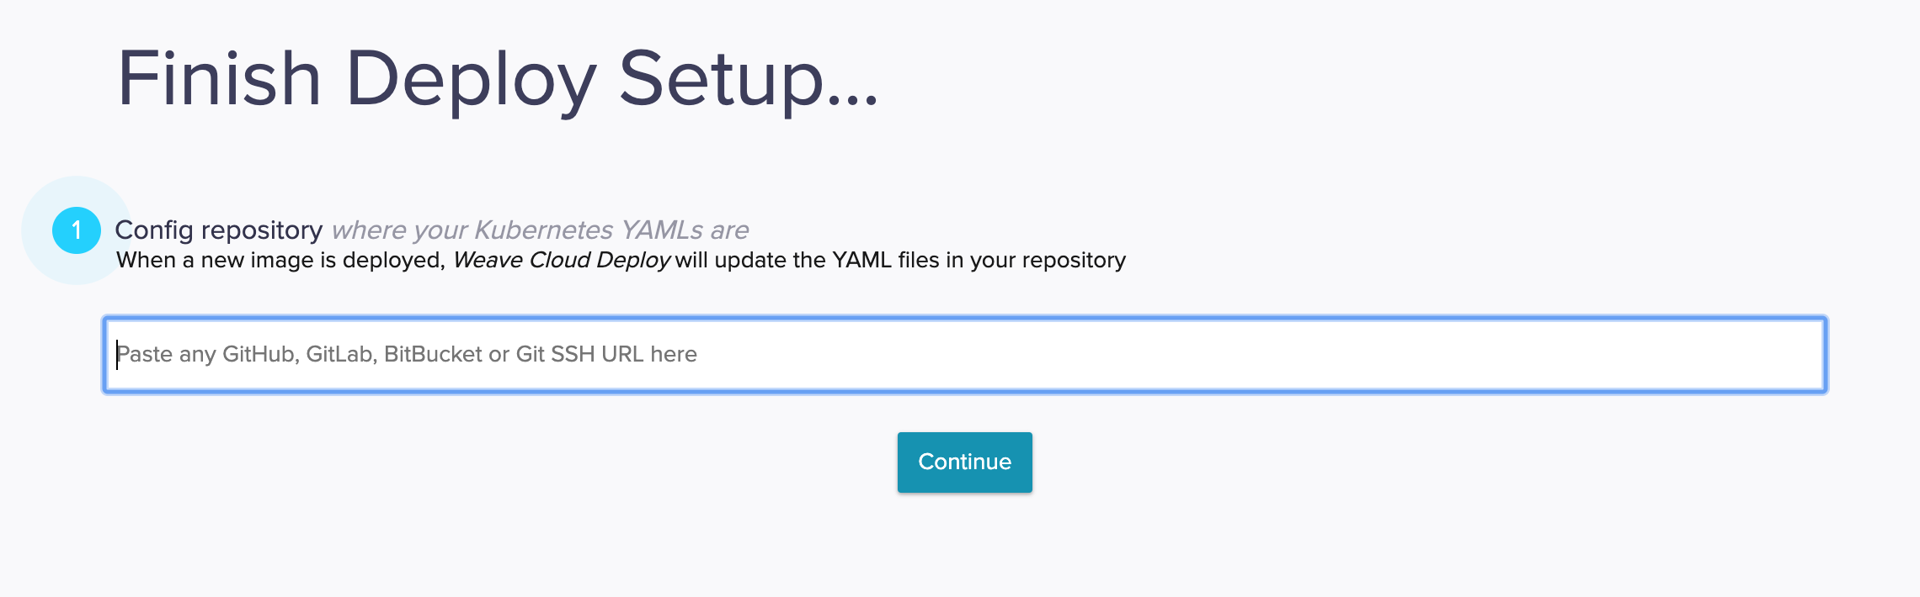
GitOps hands-on 4/10
💻
3 – Configure the agents to watch the repo
The Git SSH URL for your repo

Slide 21
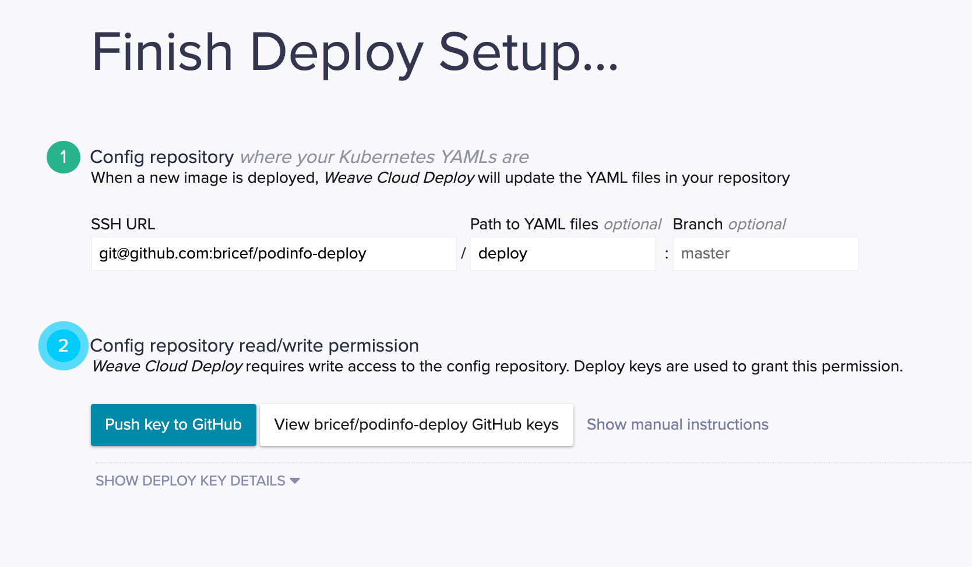
GitOps hands-on 4/10
💻
4 – Configure the agents to watch the repo
The path ‘deploy’

Slide 22
GitOps hands-on 4/10
💻
5 – Configure the agents to watch the repo
Add the access key to your Git host

Slide 23
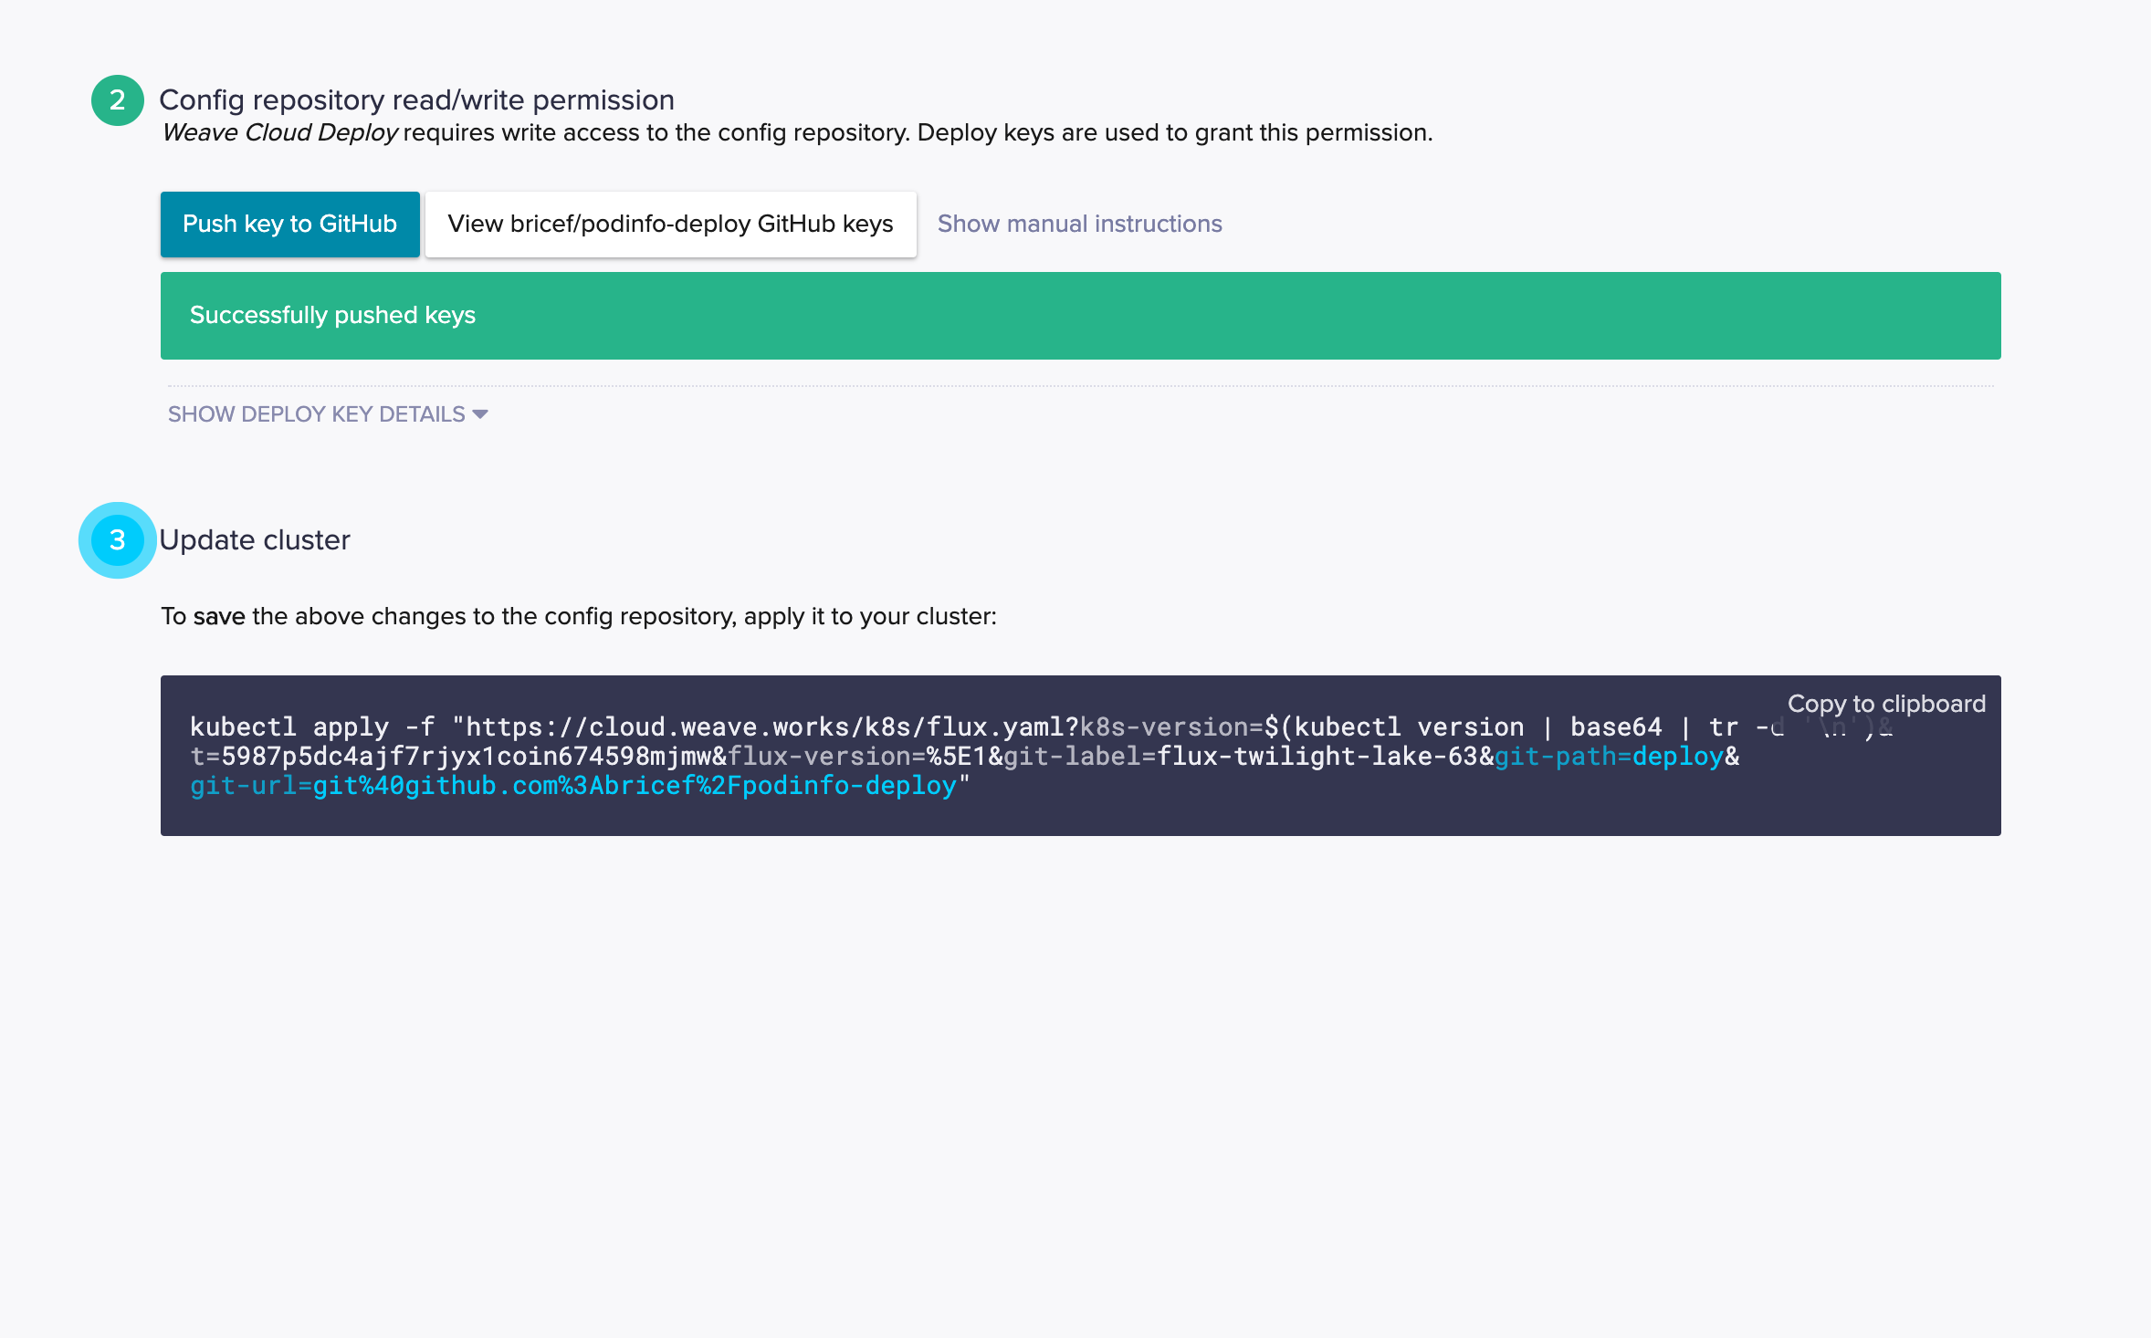
GitOps hands-on 4/10
💻
5 – Configure the agents to watch the repo
Add the access key to your Git host

Slide 24
GitOps hands-on 4/10
💻
6 – Configure the agents to watch the repo
Copy and run the command into your terminal

Slide 25
GitOps hands-on 4/10
💻
7 – Check that the service is running
Look at what’s running on the cluster with
➤ watch kubectl get -n dev all
The podinfo application should be running in your cluster in the dev namespace

Slide 26
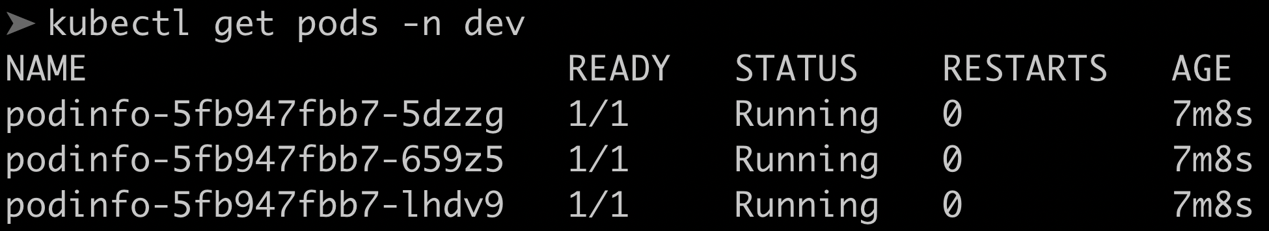
Checkpoint:
Podinfo running in the cluster

Slide 27
So what actually happened?
We installed the ‘Flux’ agent on our cluster
We added the agent key to our repository (so it can read and write the configuration)
We configured the agent to watch to our repository
The agent noticed some manifests in the repository, and applied them
Kubernetes deployed the manifests

Slide 28

Flux
github.com/fluxcd/flux

Slide 29
GitOps hands-on 4/10
💻
(Optional) - Speed up with webhooks
By default, Flux will poll the Git repository
Things are faster with Webhooks. If you’re using Github, configure webhooks.

